Slide 1


Finance and Risk analytics
Amit Kulkarni
Jai Batra

Slide 2
Content SUMMARY
Objective
Methodology
Insights and Visualization
Portfolio Analysis

Slide 3


Objective
Analyze a portfolio of stocks to offer investment management consultation tailored to the client's requirements. My task is to provide personalized advice to two different investors, Mr. Patrick Jyenger and Mr. Peter Jyenger, based on their specific needs and financial goals.
Mr. Patrick Jyenger aims to invest $500,000 in equities. As a lifelong conservative investor, he seeks to double his capital within five years while minimizing risk.
Mr. Peter Jyenger plans to invest $1 million in equities. As a lifelong high-risk investor, he seeks high-return investments and aims to double his capital within five years, accepting the associated high risks.

Slide 4
Methodology

Slide 5
Exploratory Data Analysis
Examined the dataset for null values and confirmed that no columns contained null values.
Checked the dataset for outliers.
Imputed "0" for Facebook data, as it was listed on the NYSE on May 18, 2012.
Data Analysis
Conducted various calculations, including daily returns, cumulative daily returns, Sharpe ratios, portfolio risk, and return on investment (ROI), to analyze the stock data.
Identified the best-performing stocks for all portfolios.
Utilized Power BI for enhanced visualizations.
Performed sector-wise analysis to gain a clearer understanding of each sector.
Inferences
Identified 7 top-performing stocks with over 80% returns in the last five years: AMZN, MSFT, AAPL, FB, UNH, GOOG, and MS.
AMZN offers the highest return but carries higher risk, while JNJ, RHHBY, MRK, and MSFT provide good returns with lower risk.
The Technology sector is the best performer, followed by Finance; Aviation and Health & Pharma are the worst.
Finalized the portfolio for both customers based on thorough analysis.

Slide 6
Insights and visualization

Slide 7
Ticker | Industry | Company Name
AAL | Aviation | American Airlines Group Inc
ALGT | Aviation | Allegiant Travel Company
ALK | Aviation | Alaska Air Group Inc
DAL | Aviation | Delta Air Lines Inc
HA | Aviation | Hawaiian Holdings Inc
LUV | Aviation | Southwest Airlines Co
BCS | Finance | Barclays
CS | Finance | Credit Suisse
DB | Finance | Deutsche Bank
GS | Finance | Goldman Sachs
MS | Finance | Morgan Stanley
WFC | Finance | Wells Fargo
JNJ | Healthcare | Johnson & Johnson
MRK | Healthcare | Merck and CO inc.
PFE | Healthcare | Pfizer inc
UNH | Healthcare | UnitedHealthGroup Inc
BHC | Pharmaceuticals | Bausch Health Companies inc
RHHBY | Pharmaceuticals | Roche Holding AG
AAPL | Technology | Apple Inc
AMZN | Technology | Amazon
FB | Technology | Facebook
GOOG | Technology | Alphabet
IBM | Technology | IBM
MSFT | Technology | Microsoft
Stocks Data Available
There are 24 stocks available, divided into four sectors with 6 stocks each.
The S&P 500 index is provided, which comprises the top 500 stocks in the US stock market, is used for comparison.
Below is the list of stocks along with their abbreviations, industries, and company names.

Slide 8
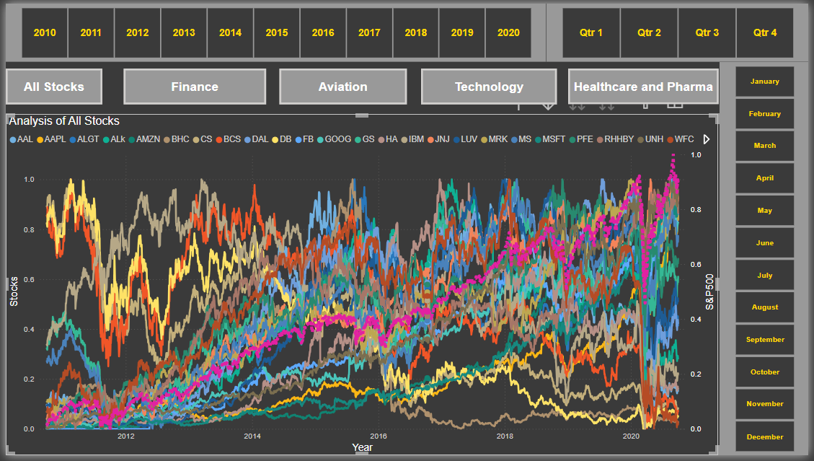
Normalized Stock Values Visualization 10-Years
The graph shows the performance of each stock compared to the S&P 500 index over the past 10 years.
We noted that Facebook entered the market on May 18, 2012.
Additionally, we included buttons on our dashboard for sector-specific analysis.
Buttons on the dashboard added for sector-specific analysis.

Slide 9
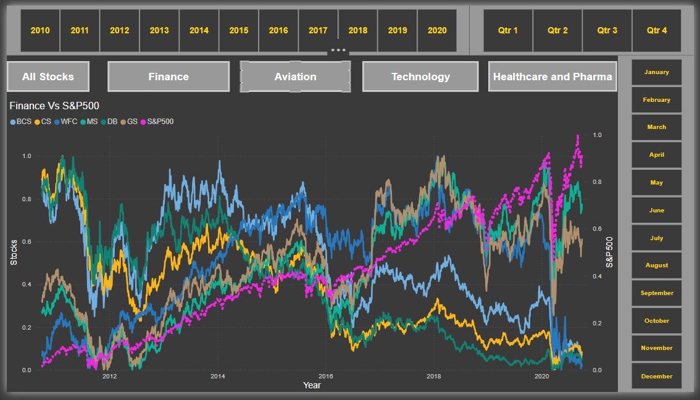
Sector Wise Analysis - Finance
The S&P 500 is positively correlated with the Finance sector.
Despite the significant market downturn in 2020 due to the COVID-19 pandemic, Morgan Stanley and Goldman Sachs managed to recover and outperform the sector, although most stocks were affected.
Goldman Sachs and Morgan Stanley show a high correlation compared to other stocks.

Slide 10
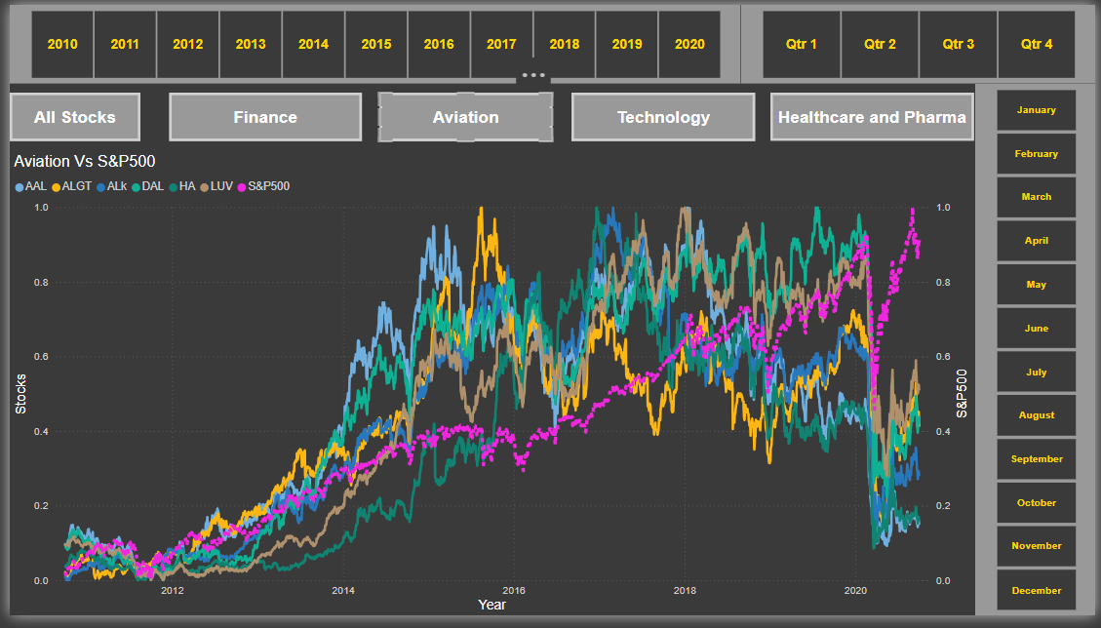
Sector Wise Analysis - Aviation
The S&P 500 is not correlated with the Aviation sector.
The market experienced a significant downturn in 2020 due to the COVID-19 pandemic, leading to a bear market.
Although the market recovered, the Aviation sector underperformed.
Allegiant Travel Company shows some positive correlation with Delta Airlines.
Delta Airlines also has a positive correlation with Southwest Airlines.

Slide 11
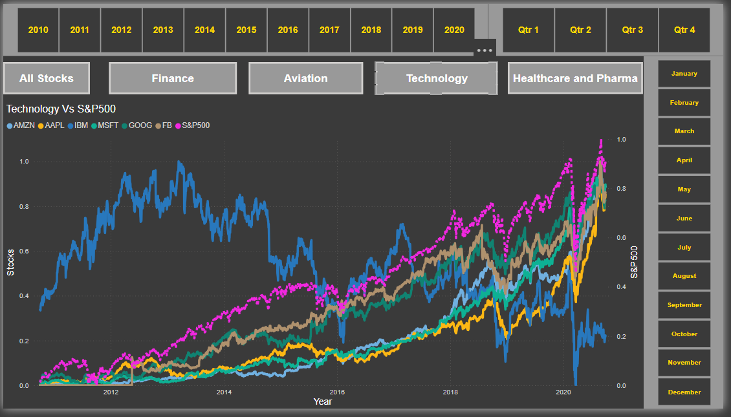
Sector Wise Analysis - Technology
The S&P 500 is strongly correlated with the Technology sector (AMZN, FB, MSFT, GOOG, AAPL).
During the pandemic, the Tech sector was one of the few to bounce back sharply.
All stocks, except for IBM, are outperforming the market.
All stocks, except for IBM, show strong correlation with each other.

Slide 12
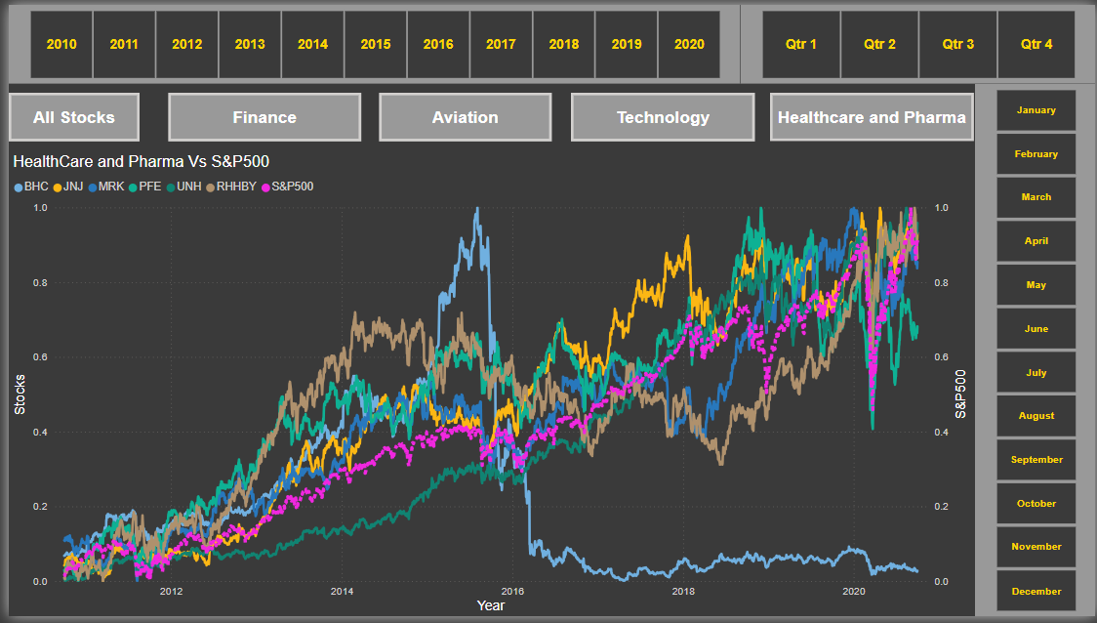
Sector Wise Analysis – Healthcare and Pharma
The S&P 500 is positively correlated with the Health and Pharma sector (JNJ, MRK, UNH).
During the pandemic, the Health and Pharma sector, along with Technology, showed rapid growth after the market crash compared to other industries.
Over the past five years, Bausch Health Companies Inc. has not seen any growth.
Overall, the Health and Pharma sector is strong compared to the S&P 500.

Slide 13
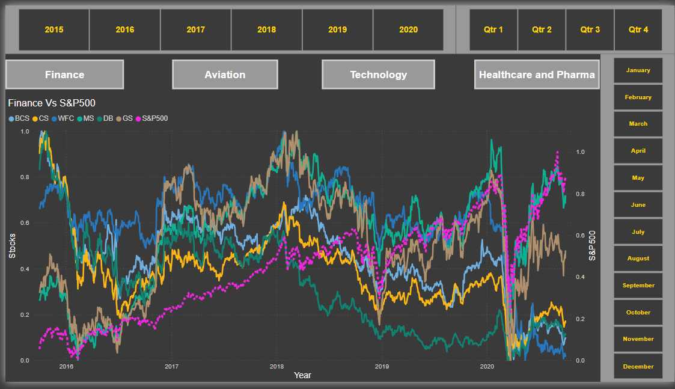
Stock Visualization Dashboard For 5 Years

Slide 14
5 Years Stock Statistics
AMZN provides annual returns of 40.59%.
MSFT provides annual returns of 34.95%.
AAPL provides annual returns of 33.32%.
FB provides annual returns of 26.45%.
UNH provides annual returns of 23.72%.
GOOG provides annual returns of 21.02%.
MS provides annual returns of 14.55%.
S&P 500 provides annual returns of 13.04%.
Stocks | Avg Daily Returns | Risk | Min | Max | Annualized_Returns | Annualized_Risk | Sharpe_Ratio | Cumulative Returns
AMZN | 0.16 | 1.9 | -7.92 | 13.22 | 40.59 | 30.11 | 1.32 | 504.69
MSFT | 0.14 | 1.75 | -14.74 | 14.22 | 34.95 | 27.84 | 1.23 | 371.49
AAPL | 0.13 | 1.87 | -12.86 | 11.98 | 33.32 | 29.73 | 1.1 | 322.74
FB | 0.1 | 2.04 | -18.96 | 15.52 | 26.45 | 32.31 | 0.8 | 187.96
UNH | 0.09 | 1.78 | -17.28 | 12.8 | 23.72 | 28.27 | 0.81 | 167.36
GOOG | 0.08 | 1.65 | -11.1 | 10.45 | 21.02 | 26.23 | 0.77 | 140.41
MS | 0.06 | 2.18 | -15.6 | 19.77 | 14.55 | 34.62 | 0.4 | 53.49
S&P500 | 0.05 | 1.21 | -11.98 | 9.38 | 13.04 | 19.18 | 0.64 | 74.81
MRK | 0.05 | 1.41 | -8.9 | 10.41 | 12.88 | 22.33 | 0.54 | 68.02
JNJ | 0.05 | 1.25 | -10.04 | 8 | 11.35 | 19.78 | 0.54 | 59.79
GS | 0.03 | 1.99 | -12.71 | 17.58 | 7.64 | 31.59 | 0.22 | 14.17
RHHBY | 0.03 | 1.35 | -8.96 | 13.01 | 7.38 | 21.45 | 0.31 | 28.87
LUV | 0.02 | 2.29 | -15.11 | 14.44 | 6.16 | 36.37 | 0.15 | -2.37
PFE | 0.02 | 1.38 | -7.73 | 8.96 | 5.25 | 21.95 | 0.21 | 15.26
DAL | 0 | 2.65 | -25.99 | 21.02 | 1.05 | 42.03 | 0.01 | -32.66
HA | 0 | 3.31 | -26.5 | 24.58 | 0.86 | 52.6 | 0 | -47.88
IBM | 0 | 1.61 | -12.85 | 11.3 | -0.04 | 25.54 | -0.03 | -15.27
ALGT | 0 | 2.91 | -28.33 | 29.24 | -1.19 | 46.2 | -0.04 | -45.04
ALk | -0.03 | 2.69 | -23.24 | 20.31 | -6.44 | 42.71 | -0.17 | -54.3

Slide 15
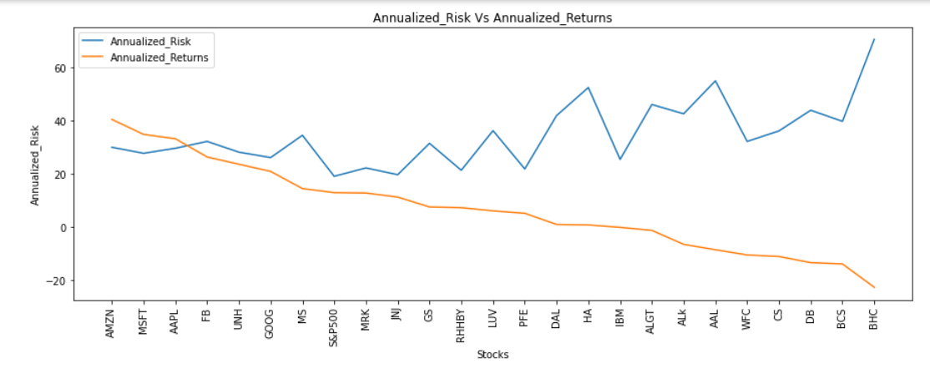
Returns Vs Risk
Top Performers: AMZN, MSFT, AAPL, FB, and UNH have annualized returns above 20%, with moderate risk.
High Risk, Low Return: BHC, BCS, DB, CS, and WFC have higher risk and lower ROI, often not meeting initial investment returns.
Risk-Free Options: Some stocks offer low-risk investments but may not provide the best returns.
Balanced Choices: JNJ, RHHBY, and MRK offer good returns with minimal risk.

Slide 16
Portfolio analysis

Slide 17
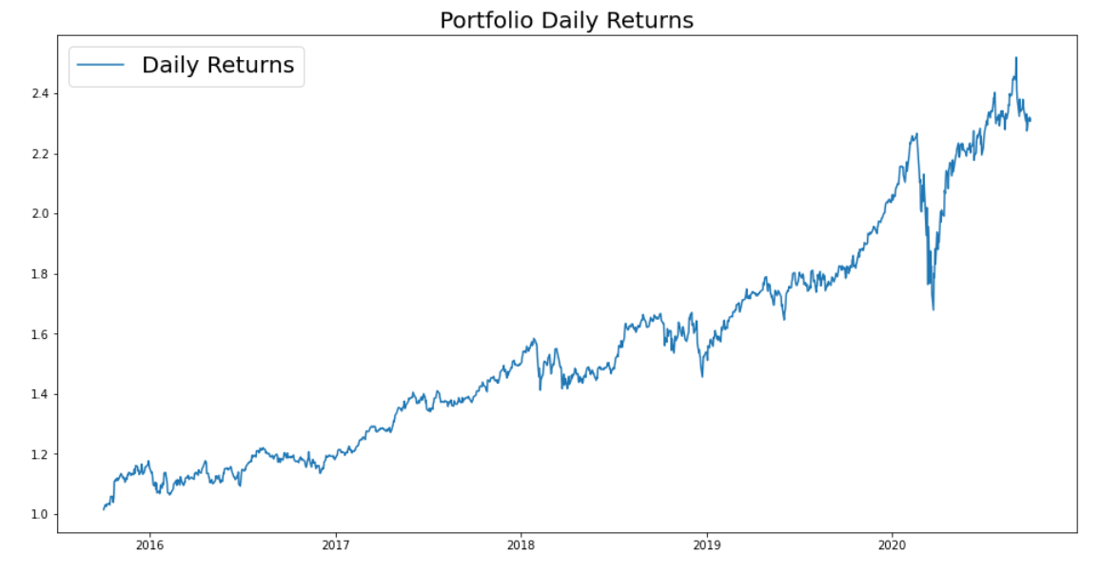
Portfolio Analysis- Patrick Jyengar
In the next five years, Mr. Patrick Jyengar aims to triple his investment. He seeks low-risk investments that will yield respectable profits.
Low-risk equities like JNJ, RHHBY, and GOOG are suitable based on his profile. However, the combined returns from these three stocks would fall short of Mr. Patrick's investment goal. Therefore, he can invest a portion of his wealth in MSFT to achieve the needed profits.
By keeping all stock weights equal at 0.25, and investing $500,000 in equities, Mr. Patrick Jyengar would see returns of $1.15 million after five years, with a gain of over $600,000.

Slide 18
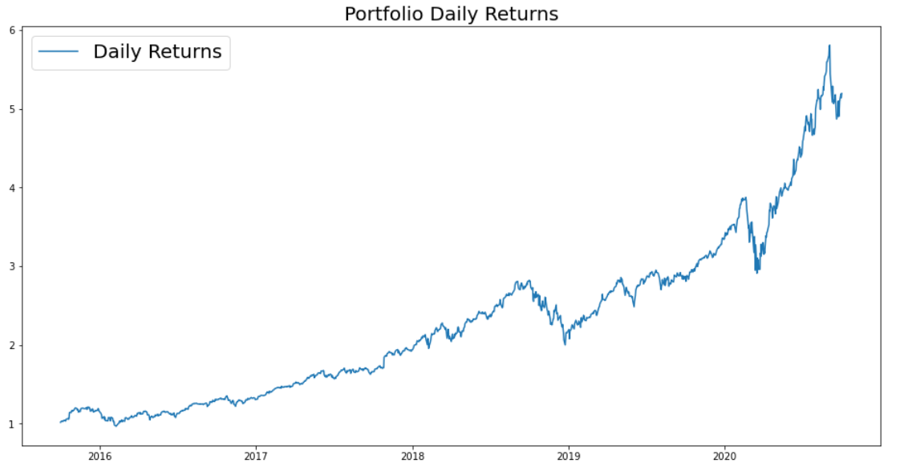
Portfolio Analysis- Peter Jyengar
Mr. Peter Jyengar prefers high-return investments and is willing to take on high risk, believing he can recover from occasional losses. He plans to invest $1 million from the company's cash in high-margin stocks for significant returns within five years.
High-risk/high-return stocks like AMZN, MSFT, and AAPL are suitable for his profile. These stocks are expected to provide maximum returns while managing the associated risks.
By investing $1 million in these equities, Mr. Peter Jyengar could see returns exceeding $5 million after five years, with a gain of over $4 million.

Slide 19
Tools and TECHNOLOGY
Anaconda-3
for
Jupyter Notebook
Microsoft Excel & PowerPoint
PowerBI
Programming Language Used Python-3
Excel – Final data-set storage and For Data Dictionary understanding
PowerPoint – For the project presentation and results showcasing
For creting and visuals, graphs and dashboards to analyze the given stock data

Slide 20
Thank You
Amit Kulkarni
Av.kulkarni25@gmail.com

